Slide 1
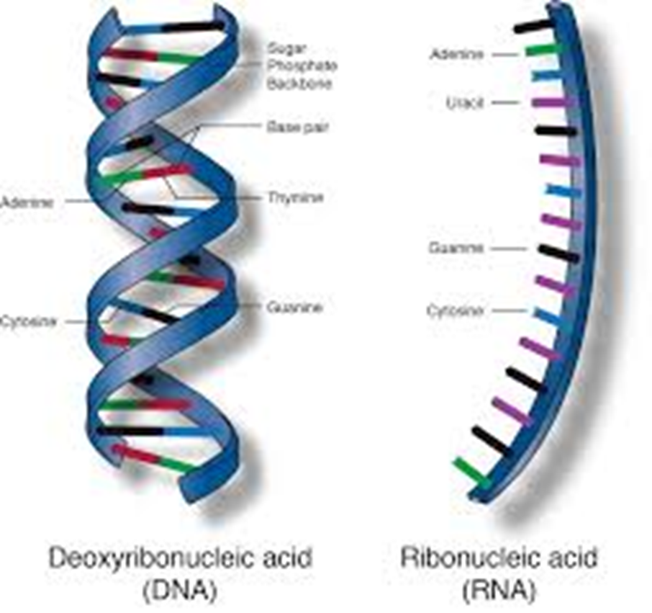
NUCLEIC ACIDS
Nucleic acid are large biological molecules essential for life.
These long thread like polymers are made up of a linear array of monomers called nucleotides.
There are two types of nucleic acid (i) Deoxyribonucleic acid (DNA) & (ii) Ribonucleic acid (RNA)

Slide 2
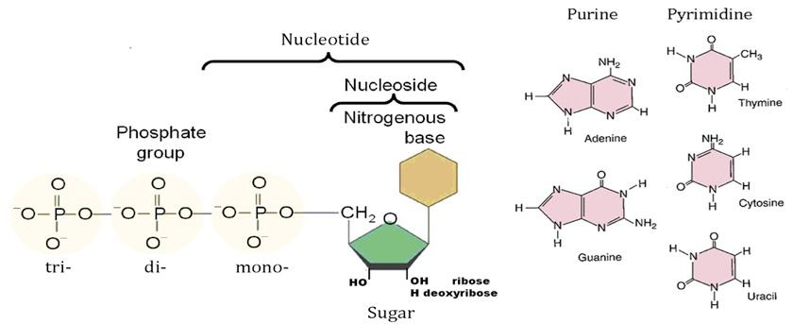
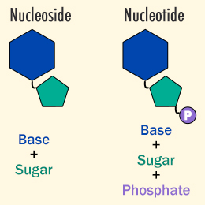
NUCLEOTIDE/NUCLEOSIDE
Notes:
A nucleotide consists of
Nitrogenous Base.
Pentose Sugar. In DNA, the sugar is 2'-deoxyribose. ...
Phosphate Group. A single phosphate group is PO₄³⁻.

Slide 3
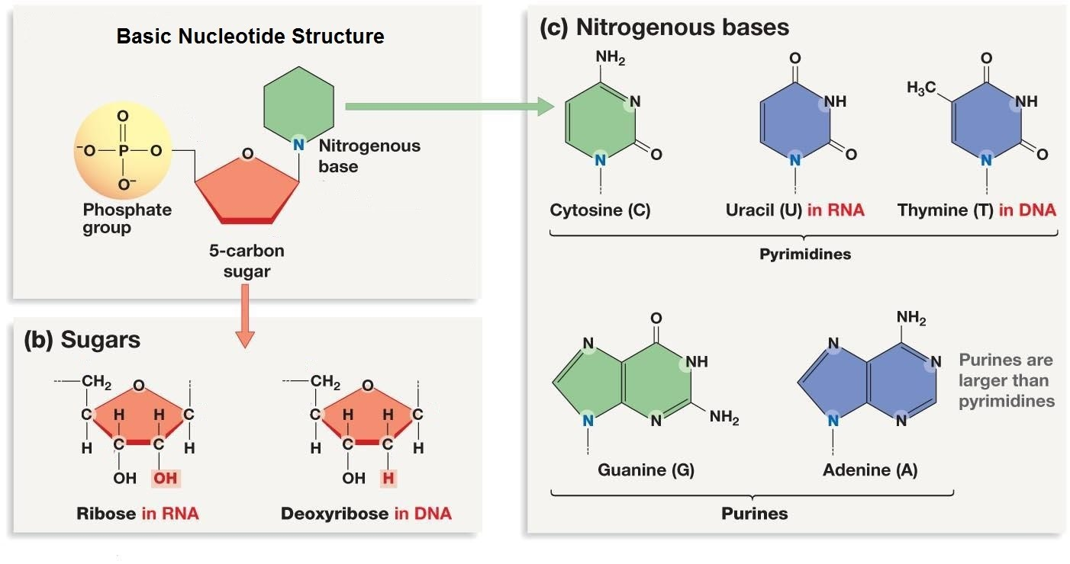
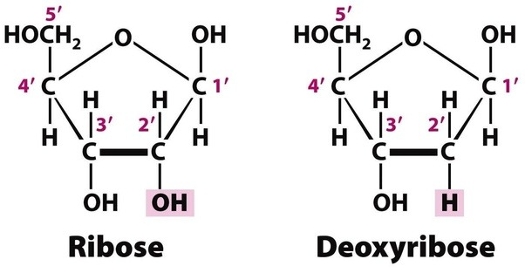
Notes:
There are are the two categories of nitrogenous bases
Purines : adenine & guanine
Pyrimidines: cytosine, thymine & uracil
Nitrogenous bases in DNA and RNA
In DNA are adenine (A), guanine (G), cytosine (C) and thymine (T).
In RNA, are adenine (A), guanine (G), cytosine (C) and uracil (U) the only differing nitrogenous base
The sugar present in a molecule of DNA is deoxyribose
The sugar present in a RNA molecule is ribose,

Slide 4
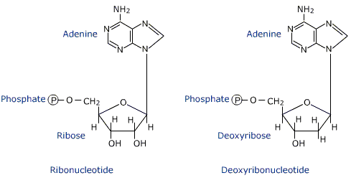

Slide 5
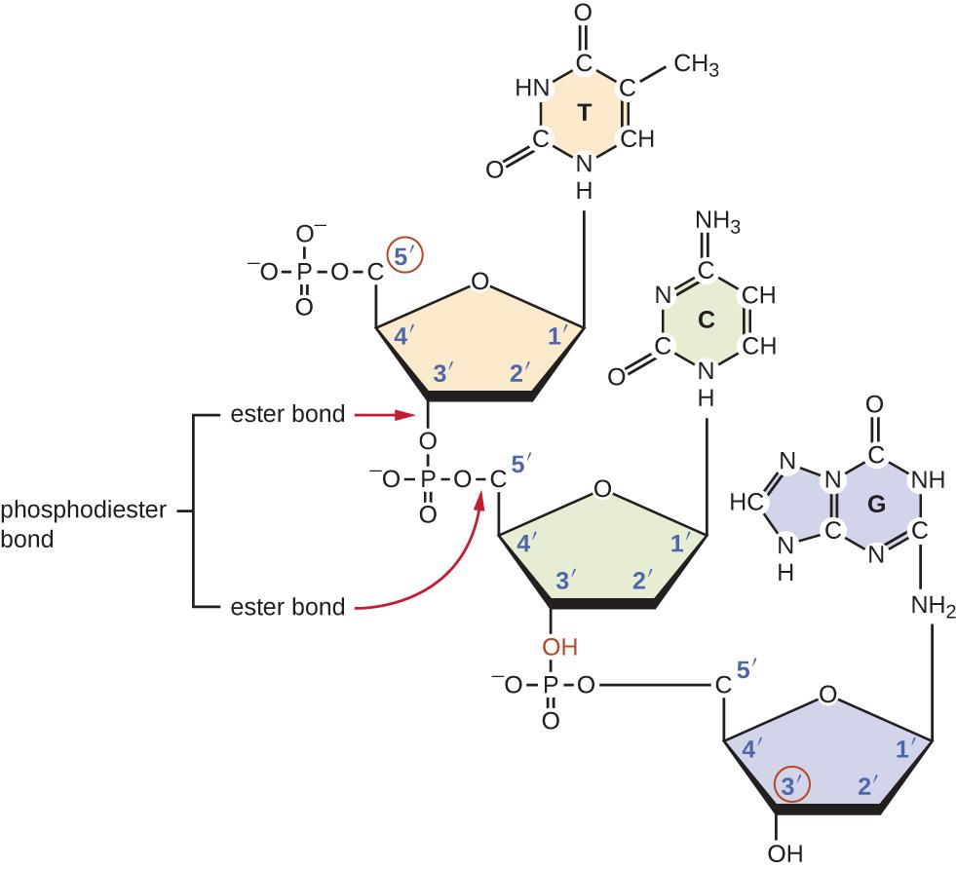
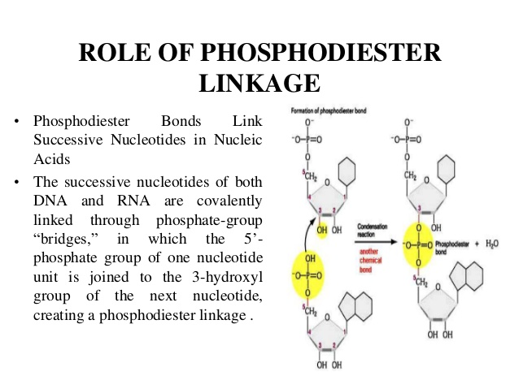
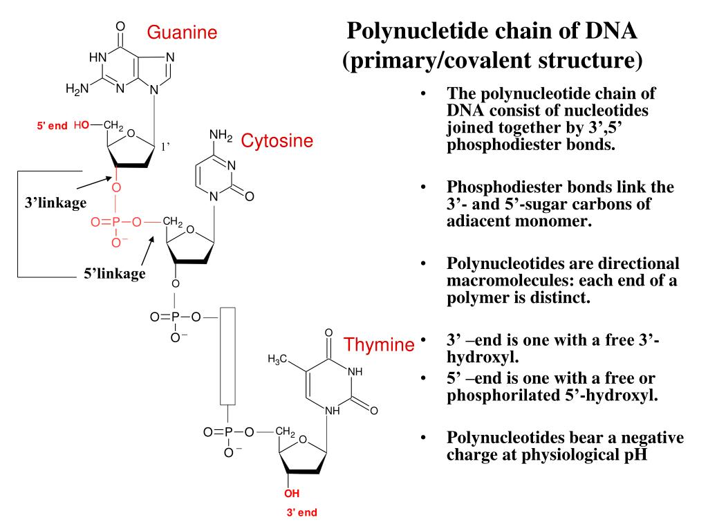
Phosphodiester linkage
Notes:
In DNA and RNA, the phosphodiester bond is the linkage between the 3' carbon atom of one sugar molecule and the 5' carbon atom of another, deoxyribose in DNA and ribose in RNA. Strong covalent bonds form between the phosphate group and two 5-carbon ring carbohydrates (pentoses) over two ester bonds.

Slide 6
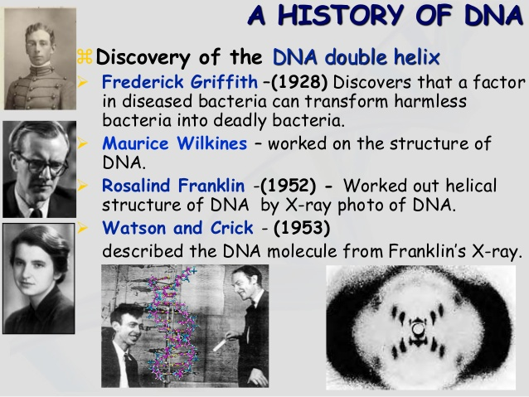
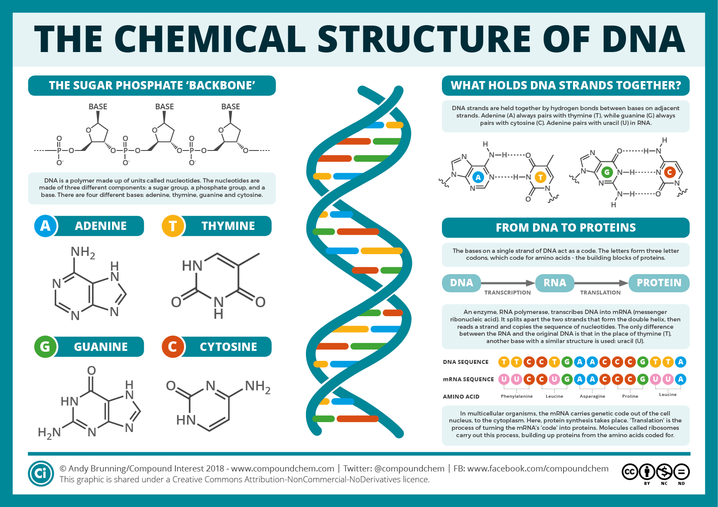
Deoxyribonucleic acid

Slide 7
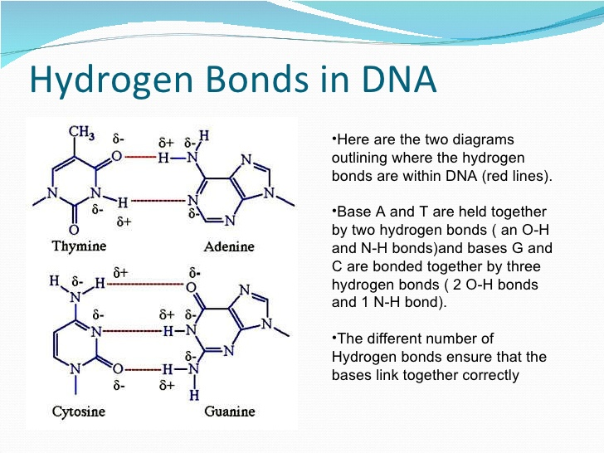
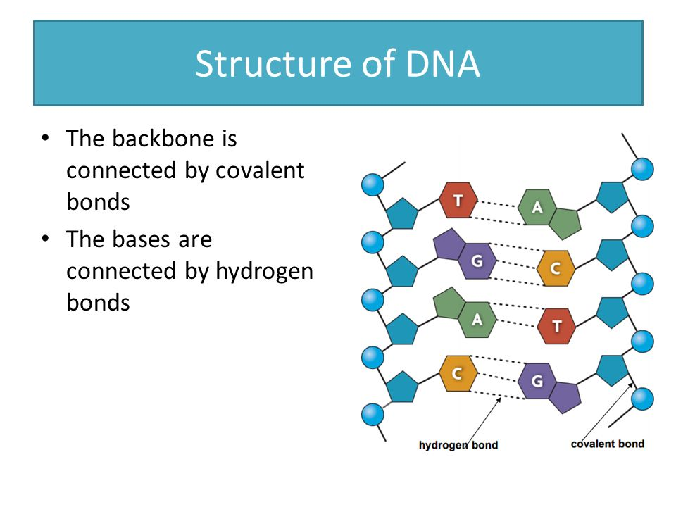
BONDS IN DNA
In DNA and RNA the backbone is composed of alternating sugar and phosphate groups which form covalent bond.

Slide 8
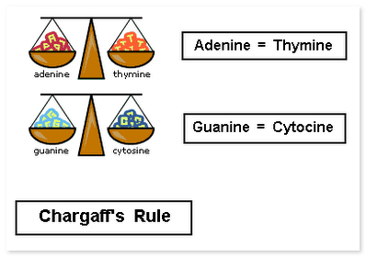
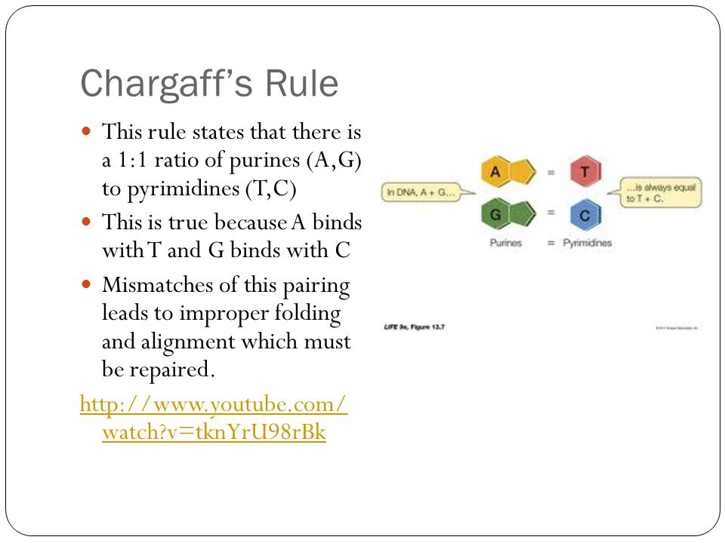
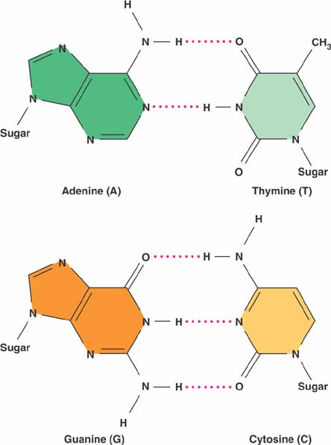
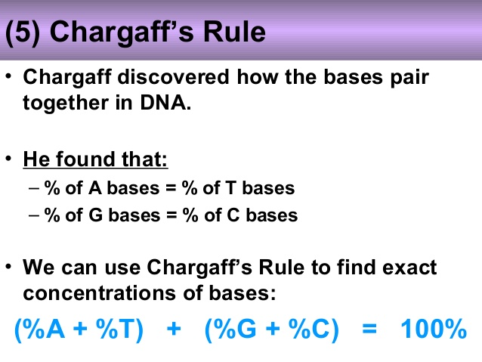
CHARGAFF’S RULE

Slide 9
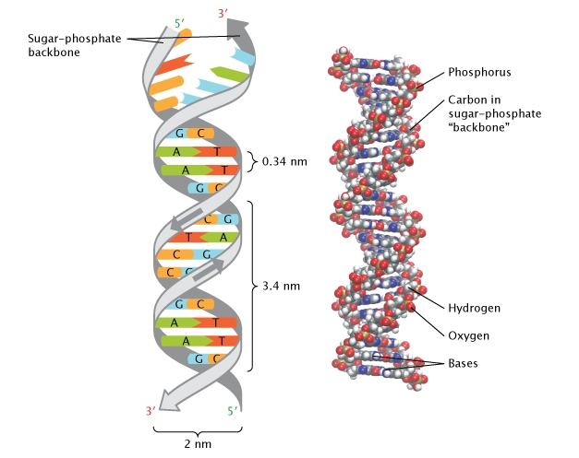
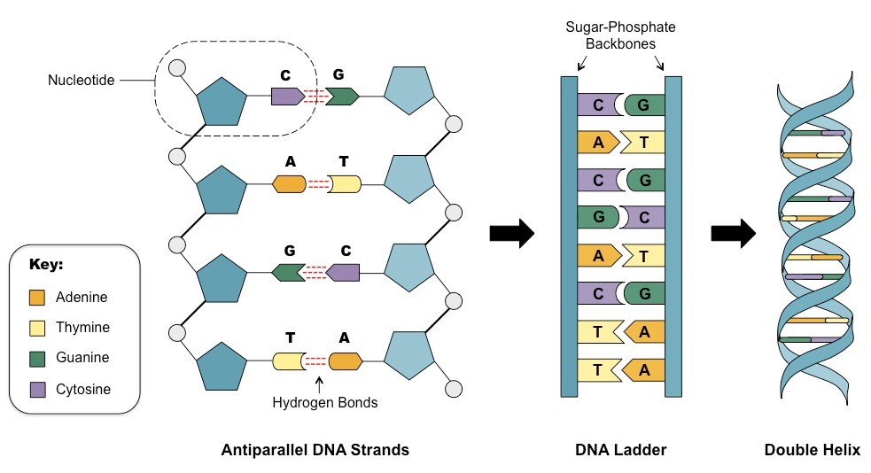
Double helical structure of DNA

Slide 10
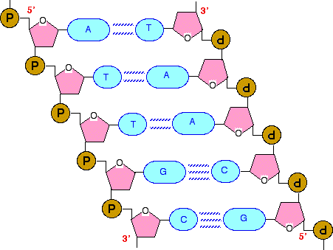
Salient features of double helical structure of DNA
The two strands are antiparallel i.e., one strand runs in the 5’ to 3’direction while the other in 3’ to 5’ direction.
The two polynucleotide chains are not identical but complementary to each other due to base pairing.
Each strand of DNA has a hydrophillic deoxyribose phosphate backbone on the outside(periphery). The two strands are held together by hydrogen bonds formed by complementary base pairs. The A-T pair has 2 hydrogen bonds while the C-G pair has 3 hydrogen bonds. The G-C is stronger by about 50% than A-T.
The hydrogen bonds are formed between a purine and pyrimidine only. The only base arrangement possible in DNA structure is A-T, T-A , G-C, C-G.
The width(or diameter) of a double helix is 20 A ˚(2nm).
Each turn (pitch)of the helix is 34A˚(3.4nm) with 10 pairs of nucleotides, each pair placed at a distance of about 3.4 A ˚(0.34nm).
The genetic information resides on one of the two strands known as template strand or sense strand. The opposite strand is antisense strand.

Slide 11
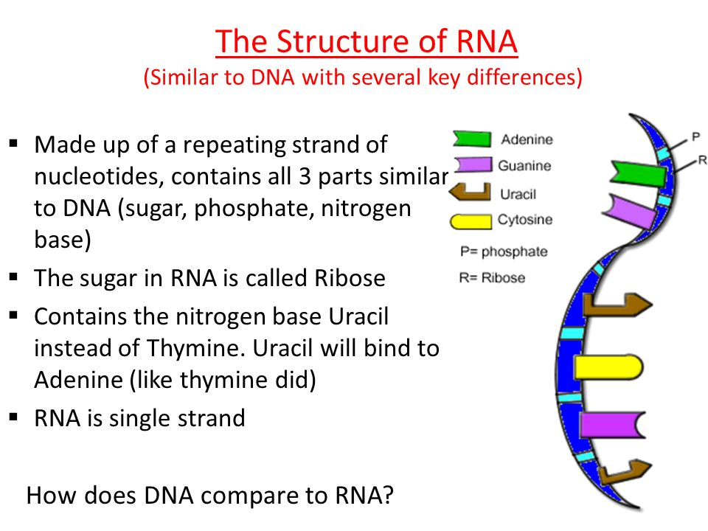
RIBONUCLEIC ACID (RNA)

Slide 12
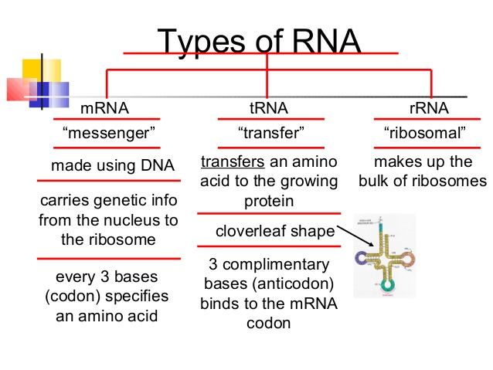
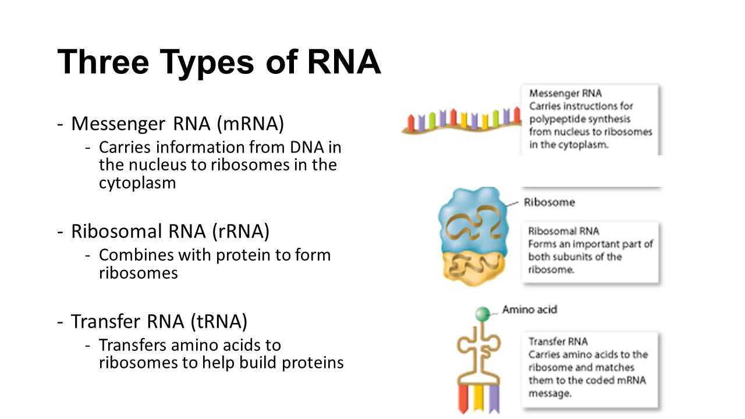

Slide 13
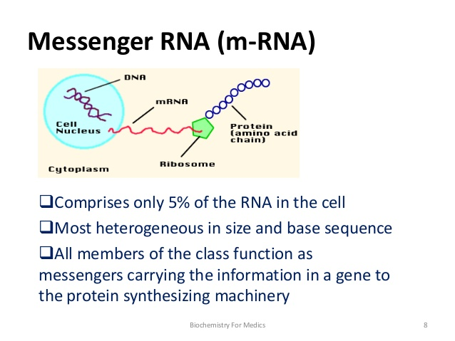
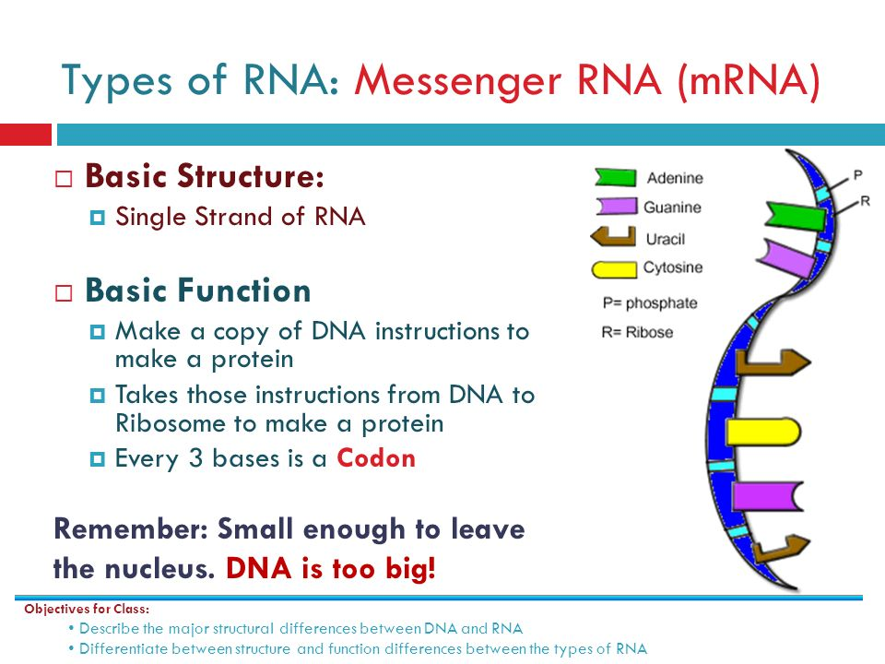
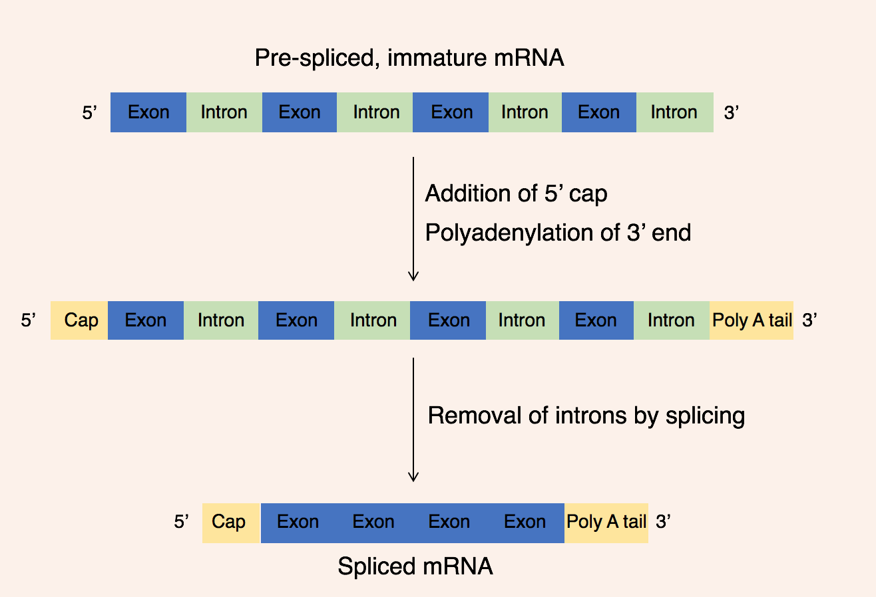
MESSENGER RNA (mRNA)

Slide 14
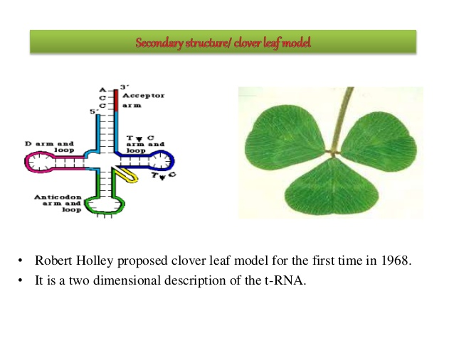
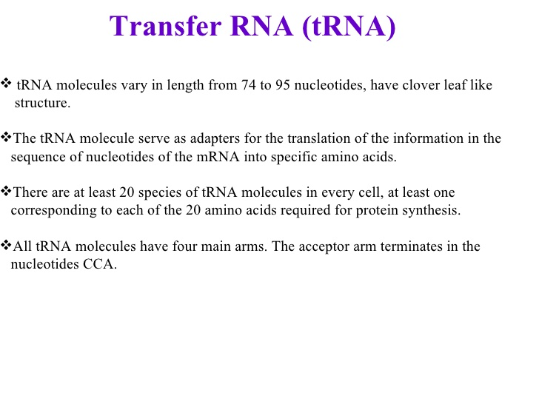
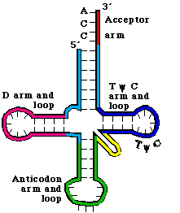
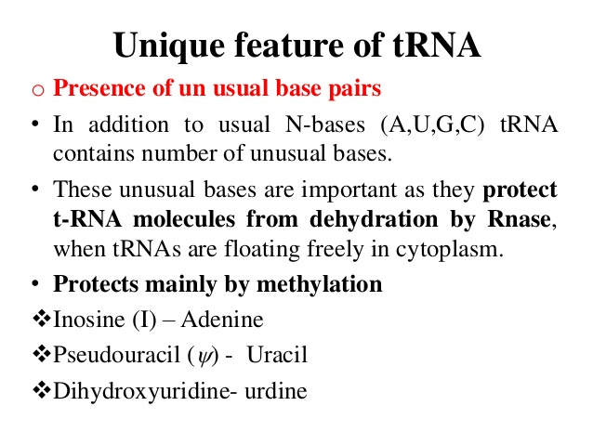
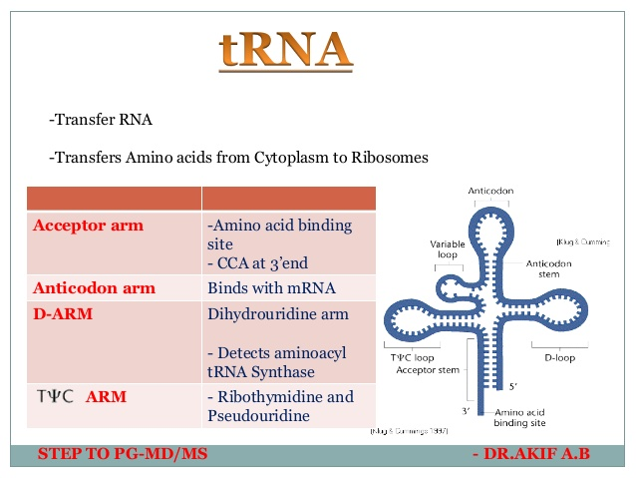
TRANSFER RNA (tRNA)

Slide 15
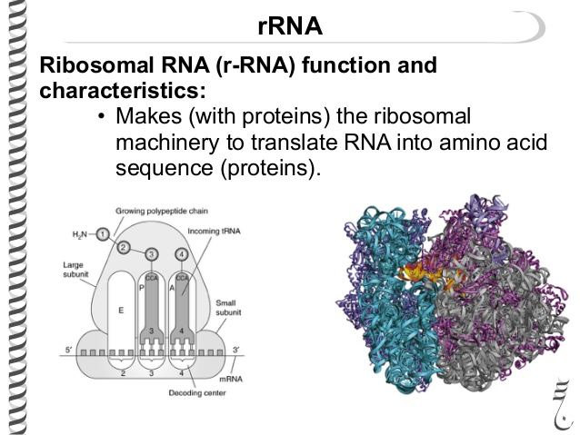
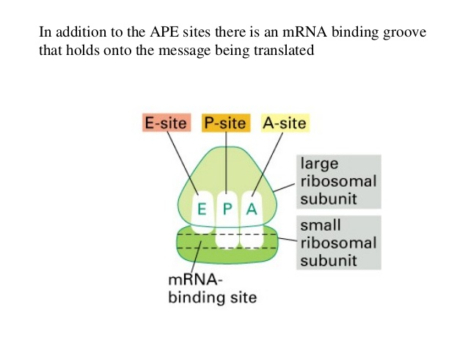
RIBOSOMAL RNA (rRNA)

Slide 16
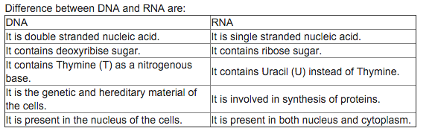
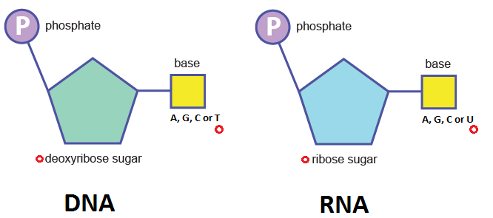
Follows Chargaff's rule |  | Doesn't follow Chargaff's rule

Slide 17
Questions
Define nucleotides and nucleosides? What are the composition of different nucleic acids?
What are the different bonds present in DNA and how are they formed?
What are the differences between DNA and RNA?
What are the salient features of the double helical structure of DNA proposed by Watson and Crick?
Explain Chargaff’s rule with and example?
What are the functions of different types of RNA?

